Slide 1
Cytoscape Network Visualization and Analysis Workshop
Welcome and Introduction
Sep.30-Oct.1, 2010
EMBL, Heidelberg

Slide 2
Course Outline
Collaborative course notes
  Wiki page: http://baderlab.org/EMBLHeidelbergCytoscapeCourse
  Google document for collaborative course notes
Introduction to gene lists, network visualization and analysis using Cytoscape
Workflow: loading a network to publication
Popular analysis scenarios
In depth application: pathway analysis of a gene list
Each module composed of lectures and labs

Slide 3
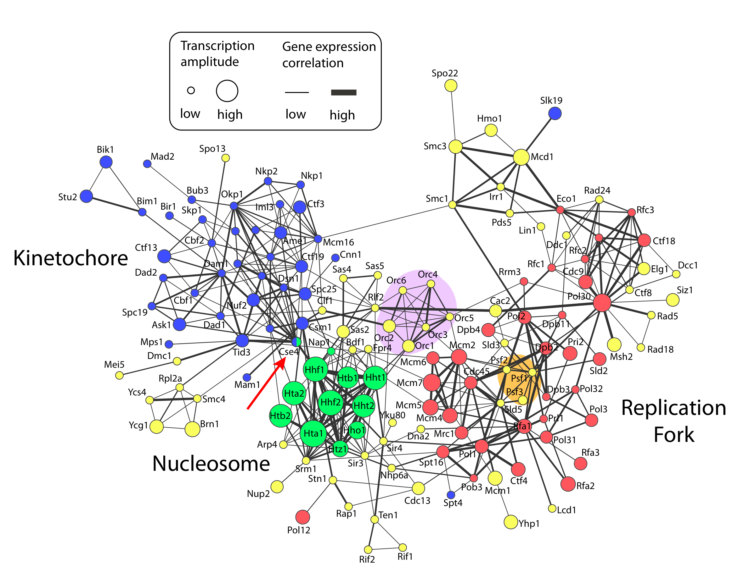

Slide 4
Cytoscape Workflow
Load Networks (Import network data into Cytoscape)‏
Load Attributes (Get data about networks into Cytoscape)‏
Analyze and Visualize Networks
Prepare for Publication
A specific example of this workflow:
  Cline, et al. “Integration of biological networks and gene expression data using Cytoscape”, Nature Protocols, 2, 2366-2382 (2007).
Notes:
TODO:
What: Schedules first part of talk
How
Bridge: So this is all about networks....

Slide 5
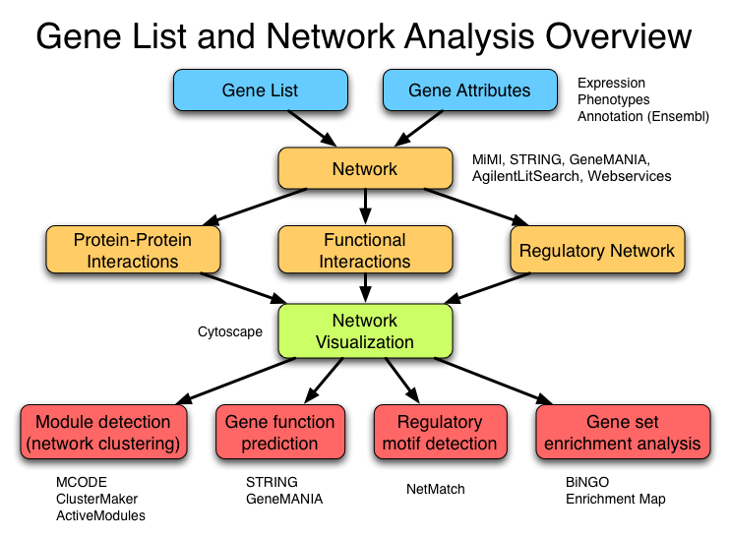

Slide 6
Schedule
Day 1
  Course introduction
  Introduction to Cytoscape
  Public seminar
  Cytoscape lectures and labs
Day 2
  Pathway analysis of gene lists lecture
  Cytoscape labs
  Developing Cytoscape plugins

Slide 7

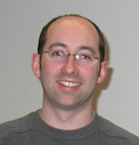
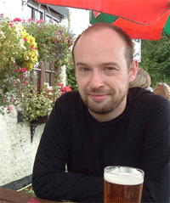

Instructor Introductions
Gary Bader
CCBR, University of Toronto
http://baderlab.org
Piet Molenaar
AMC Human Genetics,
Amsterdam, The Netherlands
http://humangenetics-amc.nl/
Network visualization and analysis using Cytoscape lectures
Network visualization and analysis using Cytoscape
Developing Cytoscape plugins in Java
Aidan Budd
Computational Biologist, Gibson Team, EMBL Heidelberg
http://www.embl.de/~budd/
Course coordinator/organizer
Pablo Minguez
Postdoctoral Fellow, Bork Group
EMBL Heidelberg
http://www.embl.de/research/units/scb/bork/members/?s_personId=6034
Assisting with labs, Cytoscape user

Slide 8
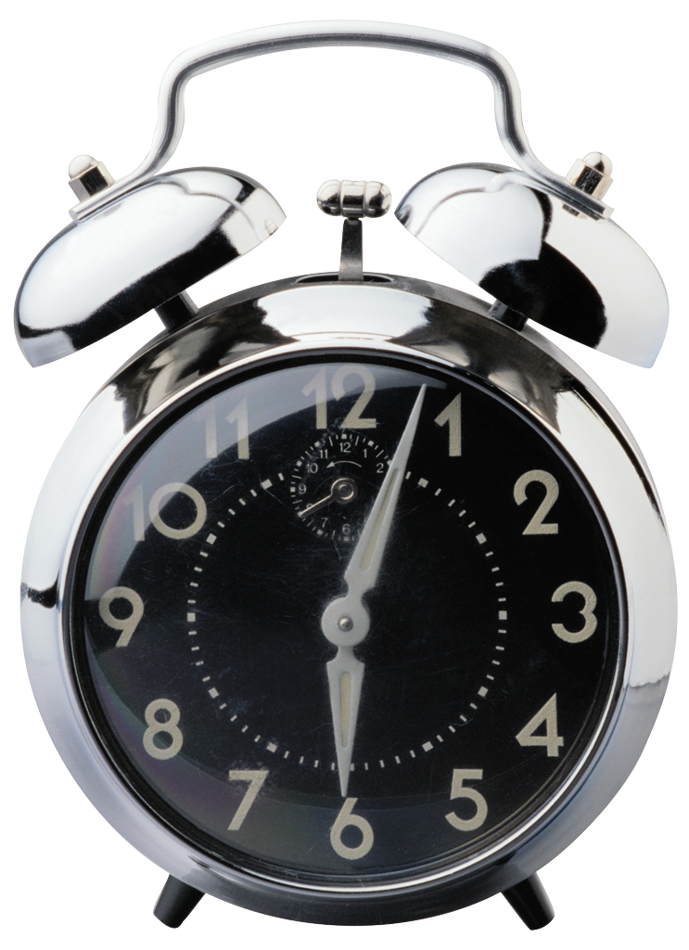
Participant Introductions
Where are you from?
What research do you do?
Where does your gene list or network come from? (i.e. what type of experiment?)
1 Minute Each

Slide 9
Logistics
Contact information
Housekeeping
Meals
Take advantage of class & break times to peer network!
Questions: Just ask any one of us, we will all be here for the two days.

Slide 10
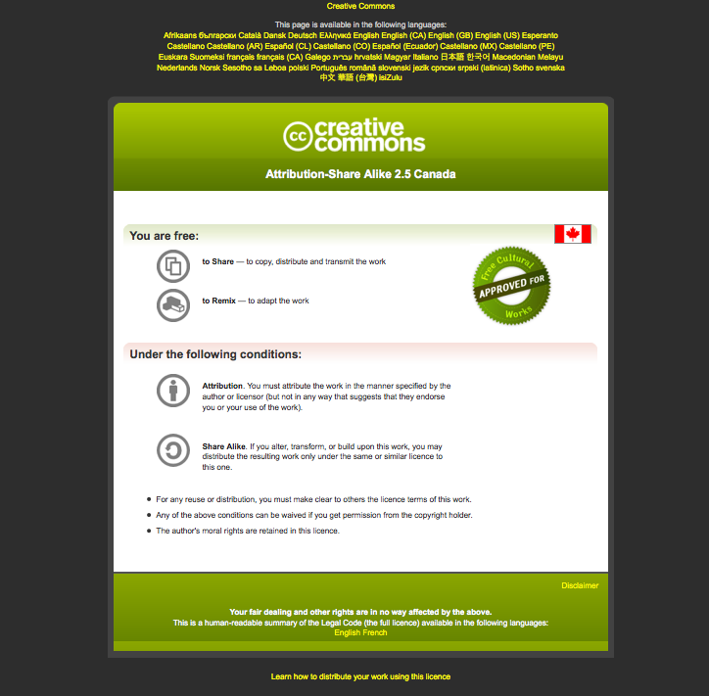
Scooter Morris
Piet Molenaar
Gary Bader
Tero Aittokallio
Boris Steipe
Canadian Bioinformatics Workshops
Module #: Title of Module
10

Slide 11
Introduction to Gene Lists and Networks
Gary Bader

Slide 12
Gene Lists and Networks Outline
Gene lists
  Where they come from
  What do they mean
Networks
  What are they
  Analysis
  Use in Biology
  Biological questions/applications

Slide 13
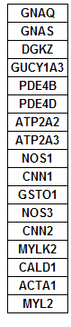
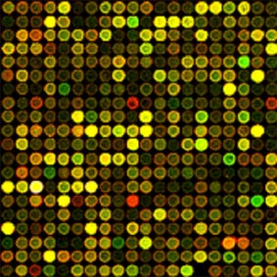
Interpreting Gene Lists
My cool new screen worked and produced 1000 hits! …Now what?
Genome-Scale Analysis (Omics)
  Genomics, Proteomics
Tell me what’s interesting about these genes
Ranking or
clustering
?
GenMAPP.org

Slide 14
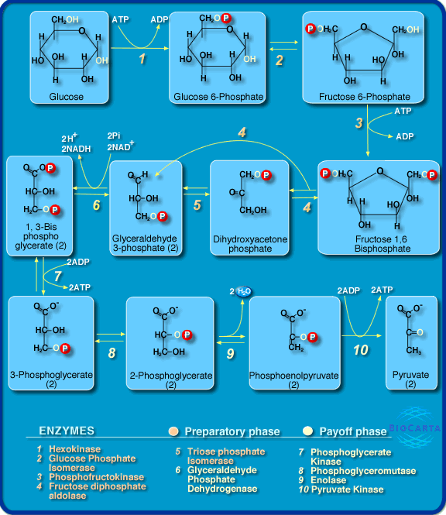
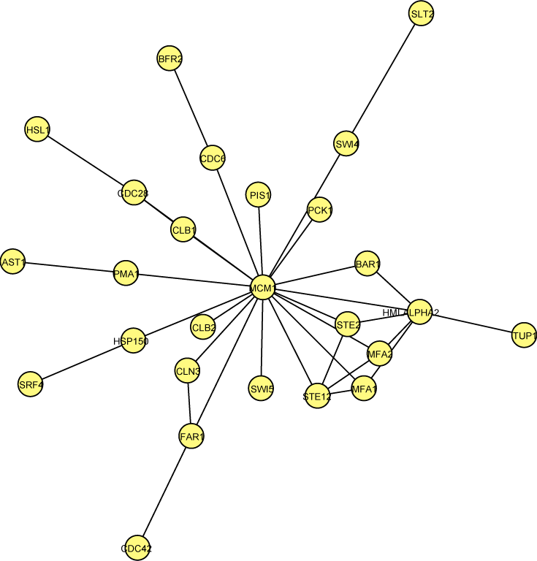

Interpreting Gene Lists
My cool new screen worked and produced 1000 hits! …Now what?
Genome-Scale Analysis (Omics)
  Genomics, Proteomics
Tell me what’s interesting about these genes
  Are they enriched in known pathways, complexes, functions
Ranking or
clustering
Analysis tools
Eureka! New
heart disease
gene!
Prior knowledge about cellular processes

Slide 15
Where Do Gene Lists Come From?
Molecular profiling e.g. mRNA, protein
  Identification → Gene list
  Quantification → Gene list + values
  Ranking, Clustering (biostatistics)
Interactions: Protein interactions, microRNA targets, transcription factor binding sites (ChIP)
Genetic screen e.g. of knock out library
Association studies (Genome-wide)
  Single nucleotide polymorphisms (SNPs)
  Copy number variants (CNVs)

Slide 16
What Do Gene Lists Mean?
Biological system: complex, pathway, physical interactors
Similar gene function e.g. protein kinase
Similar cell or tissue location
Chromosomal location (linkage, CNVs)
Data

Slide 17
Gene Lists and Networks Outline
Gene lists
  Where they come from
  What do they mean
Networks
  What are they
  Analysis
  Use in Biology
  Biological questions/applications

Slide 18
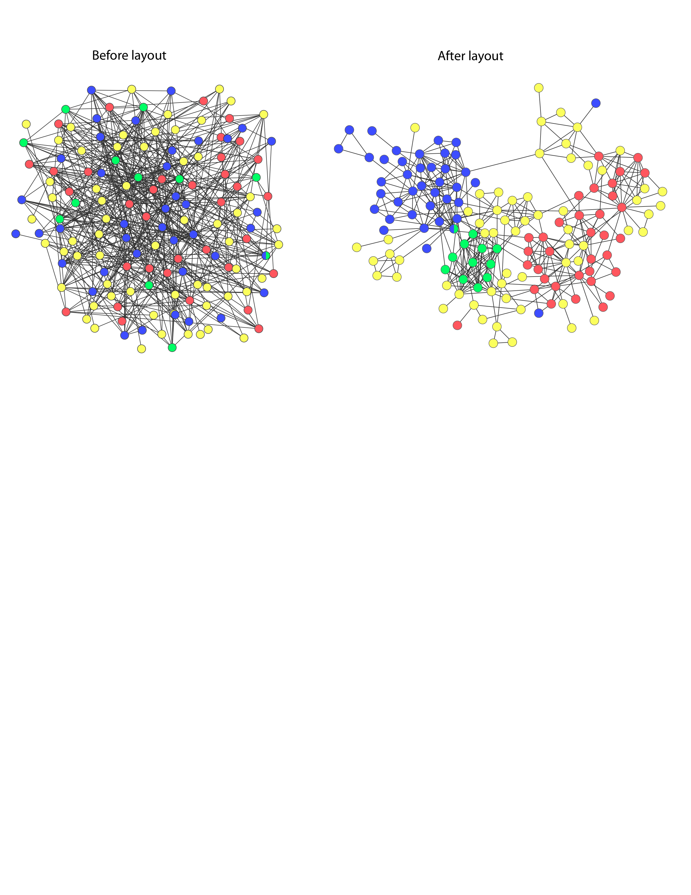
Networks
Represent relationships
  Physical, regulatory, genetic, functional interactions
Useful for discovering relationships in large data sets
  Better than tables in Excel
Visualize multiple data types together
  See interesting patterns

Slide 19
Mapping Biology to a Network
A simple mapping
  one compound/node, one interaction/edge
A more realistic mapping
  Cell localization, cell cycle, cell type, taxonomy
  Only represent physiologically relevant interaction networks
Edges can represent other relationships
Critical: understand the mapping for network analysis

Slide 20

Protein Sequence Similarity Network
http://apropos.icmb.utexas.edu/lgl/

Slide 21
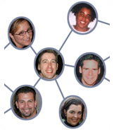
Six Degrees of Separation
Everyone in the world is connected
by at most six links
Which path should we take?
Shortest path by breadth first search
  If two nodes are connected, will find the shortest path between them
Are two proteins connected? If so, how?
Biologically relevant?
http://www.time.com/time/techtime/200406/community.html

Slide 22
Biological Questions
Step 1: What do you want to accomplish with your list or network (hopefully part of experiment design! ☺ )
  Summarize biological processes or other aspects of gene function
  Find a controller for a process (TF, miRNA)
  Find new pathways or new pathway members
  Discover new gene function
  Correlate with a disease or phenotype (candidate gene prioritization)
  Perform differential analysis – what’s different between samples?
Other
Questions?

Slide 23
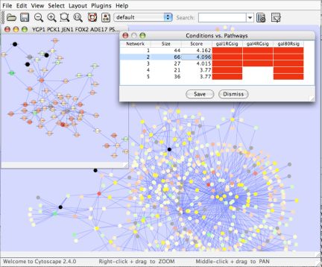
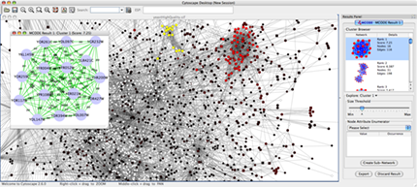
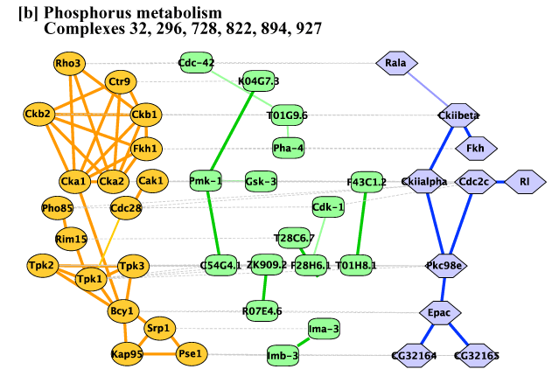
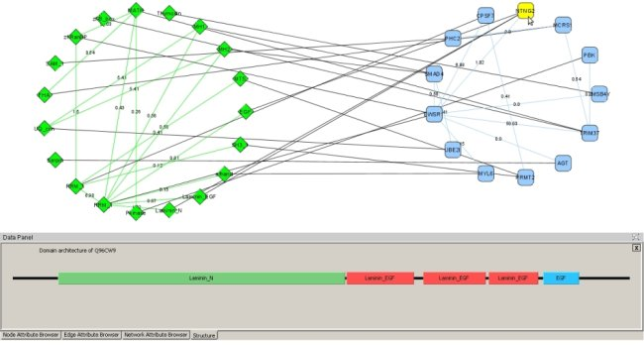
Applications of Network Biology
Gene Function Prediction –
shows connections to sets of genes/proteins involved in same biological process
Detection of protein complexes/other modular structures –
discover modularity & higher order organization (motifs, feedback loops)
Network evolution –
biological process(es) conservation across species
Prediction of new interactions and functional associations –
Statistically significant domain-domain correlations in protein interaction network to predict protein-protein or genetic interaction
jActiveModules, UCSD
MCODE, University of Toronto
PathBlast, UCSD
DomainGraph, Max Planck Institute

Slide 24
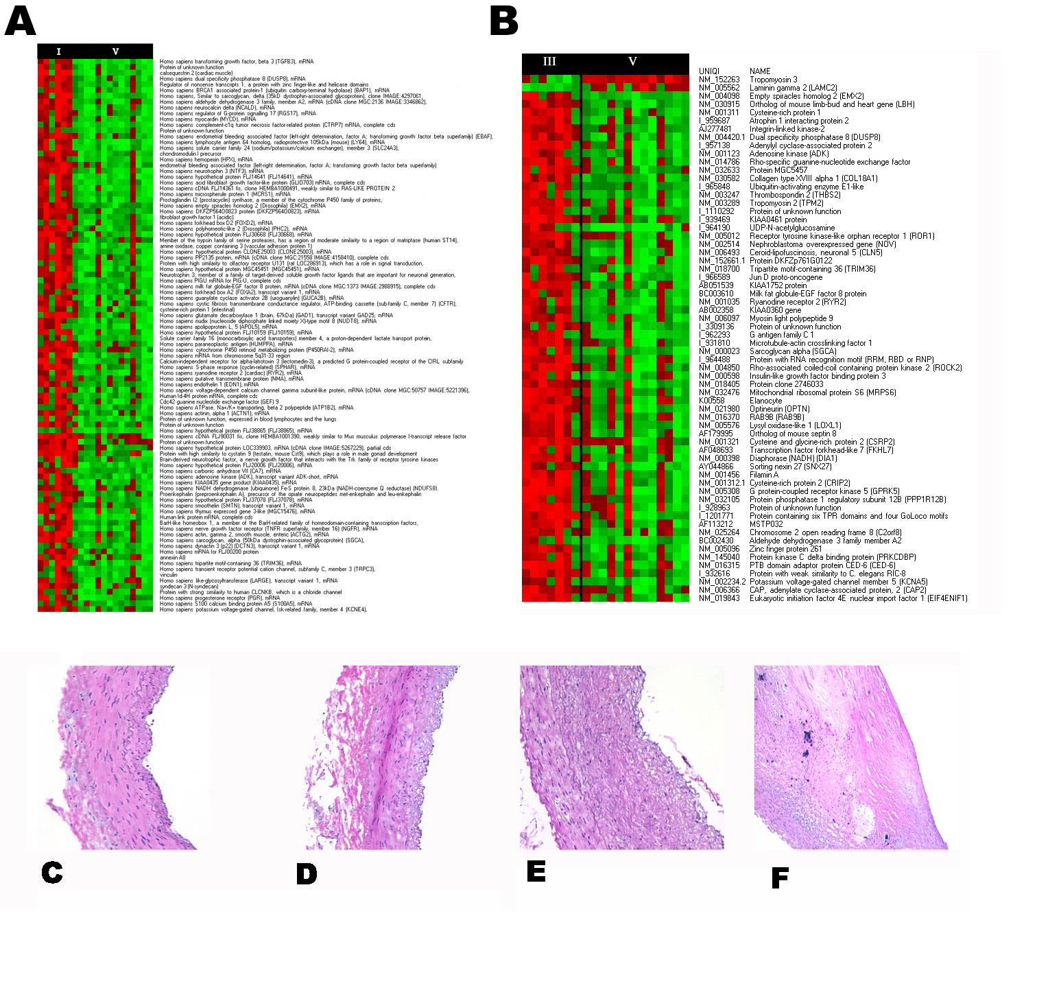
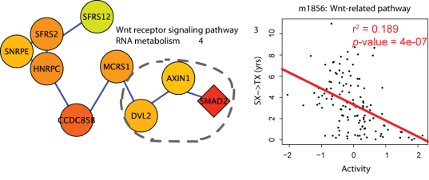
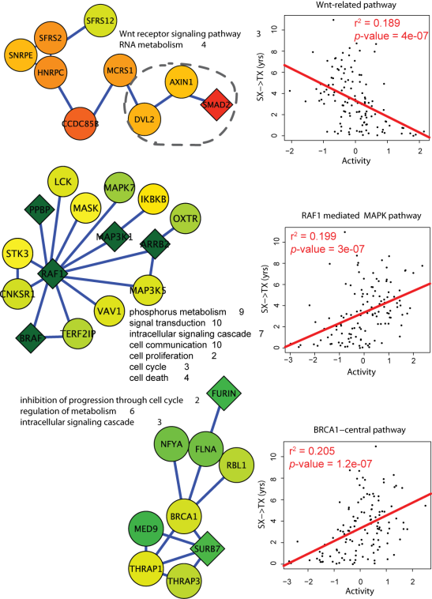
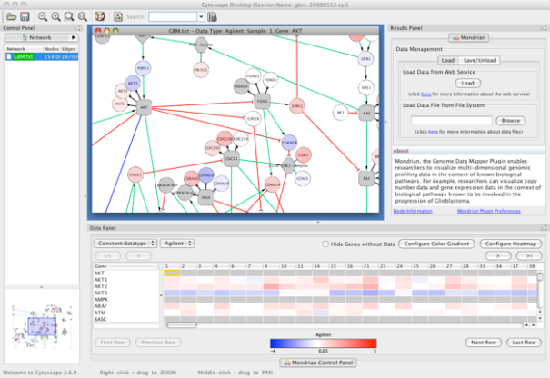
Applications of Network Informatics in Disease
Identification of disease subnetworks – identification of disease network subnetworks that are transcriptionally active in disease.
Subnetwork-based diagnosis – source of biomarkers for disease classification, identify interconnected genes whose aggregate expression levels are predictive of disease state
Subnetwork-based gene association – map common pathway mechanisms affected by collection of genotypes
Agilent Literature Search
PinnacleZ, UCSD
Mondrian, MSKCC
June 2009

Slide 25
What Have We Learned?
Gene lists can be interpreted in the context of known biological processes
Networks are useful for seeing relationships in large data sets
Important to understand what the nodes and edges mean
Important to define the biological question - know what you want to do with your gene list or network
Many methods available for gene list and network analysis

Slide 26
Introduction to Network Visualization
Gary Bader

Slide 27
Network Visualization Outline
Automatic network layout
Visual features
Visually interpreting a network

Slide 28
Automatic network layout

Slide 29
Automatic network layout
Force-directed: nodes repel and edges pull
Good for up to 500 nodes
  Bigger networks give hairballs - Reduce number of edges
Advice: try force directed first, or hierarchical for tree-like networks
Tips for better looking networks
  Manually adjust layout
  Load network into a drawing program (e.g. Illustrator) and adjust labels

Slide 30
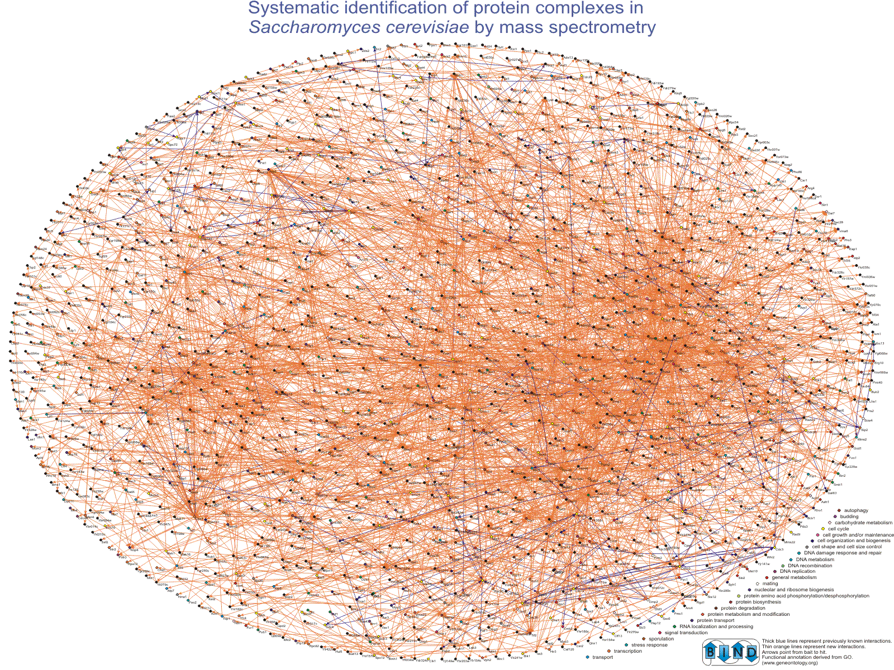
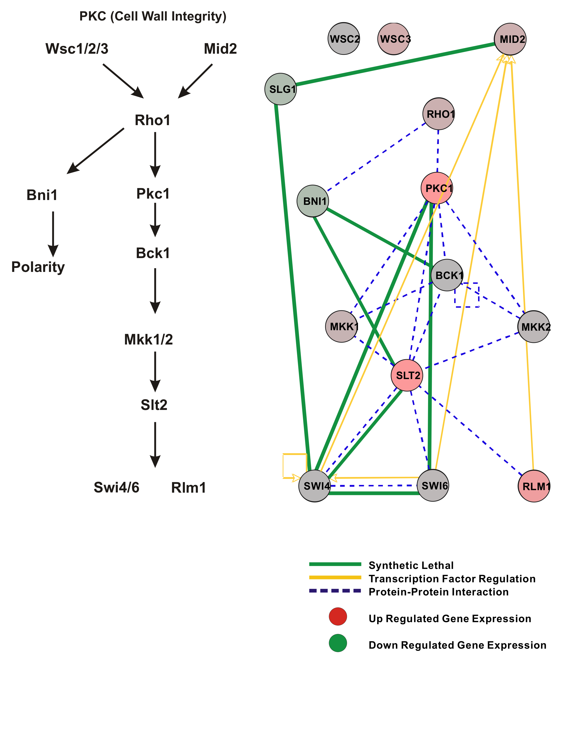
Overview
Zoom
Focus
PKC Cell Wall Integrity

Slide 31
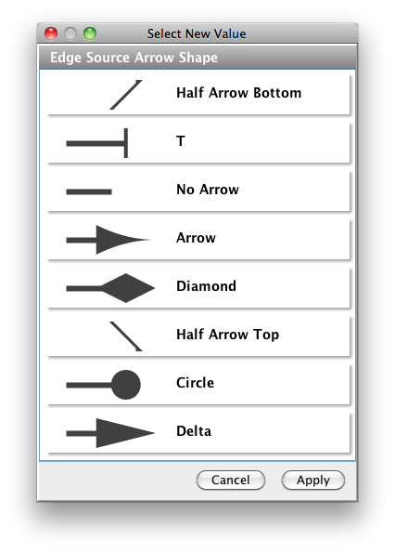
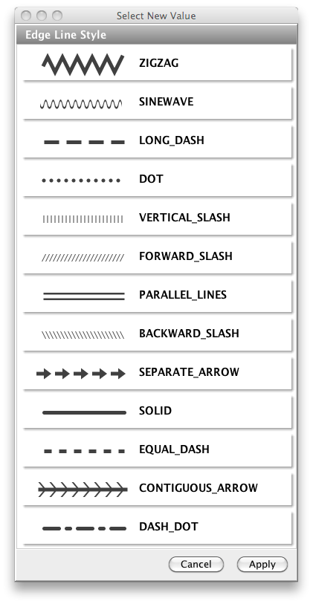
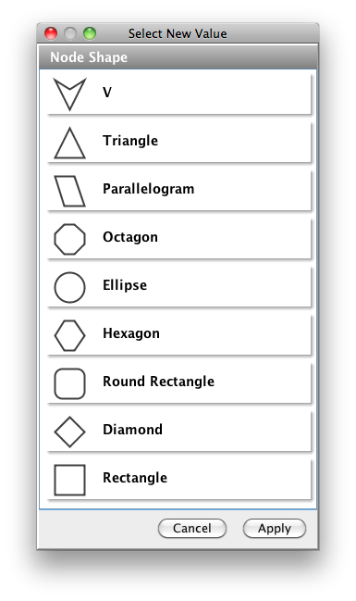
Visual Features
Node and edge attributes
  String, integer, float, Boolean, list
  E.g. represent gene, interaction attributes
Visual attributes
  Node, edge visual properties
  Colour, shape, size, borders, opacity...

Slide 32
Visual Features
Guilt-by-association
Dense clusters
Global relationships

Slide 33
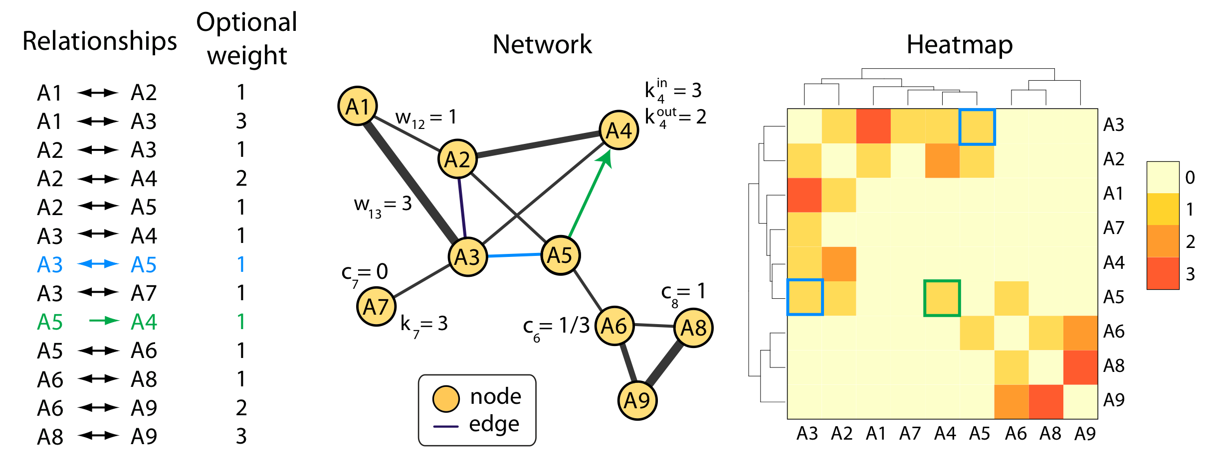
Network Representations

Slide 34
What Have We Learned?
Automatic layout is required to visualize networks
Networks help you visualize interesting relationships in your data
Avoid hairballs by focusing analysis
Visual attributes enable multiple types of data to be shown at once – useful to see their relationships

Slide 35
Network Visualization/Analysis using Cytoscape
Network visualization and analysis using Cytoscape software
Cytoscape basics
Cytoscape network analysis examples

Slide 36
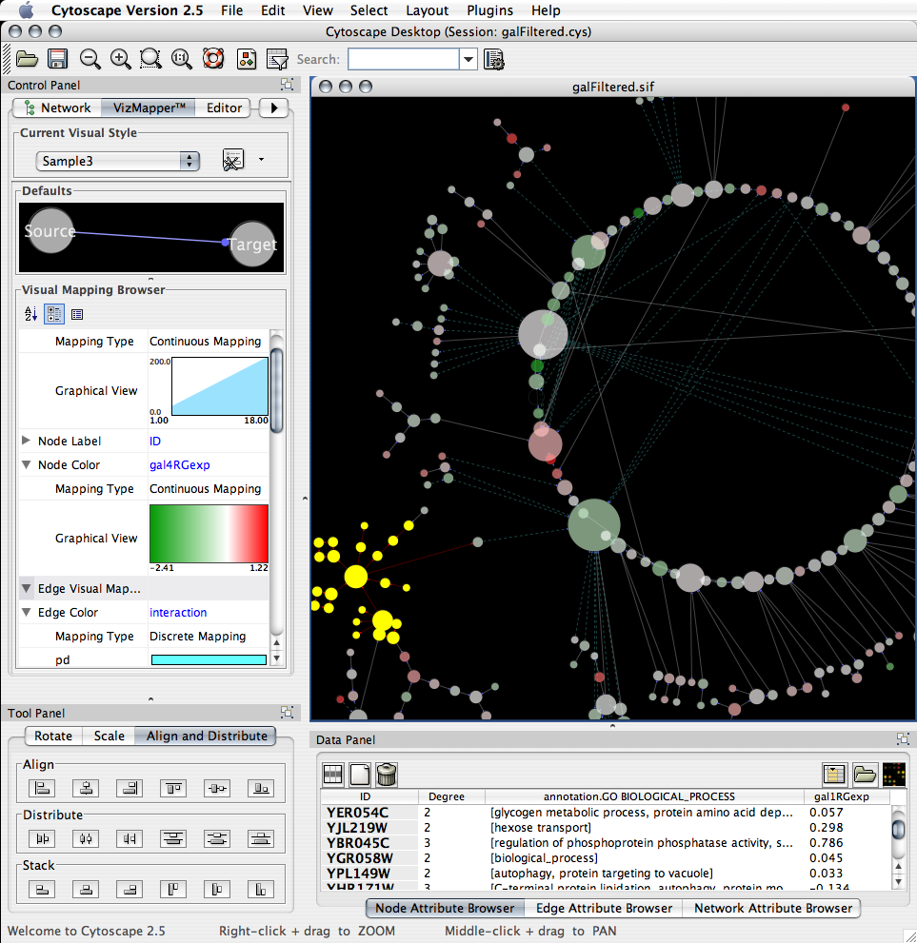
Network visualization and analysis
http://cytoscape.org
Pathway comparison
Literature mining
Gene Ontology analysis
Active modules
Complex detection
Network motif search
UCSD, ISB, Agilent, MSKCC, Pasteur, UCSF, Unilever, UToronto, U Texas

Slide 37
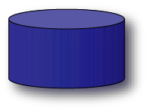
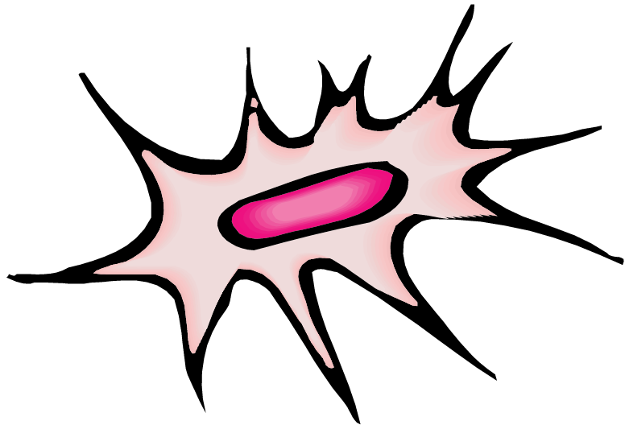

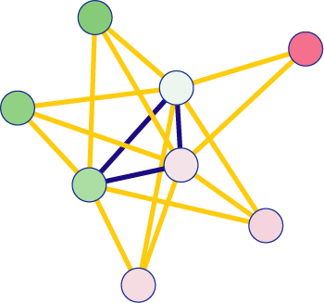



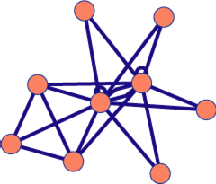
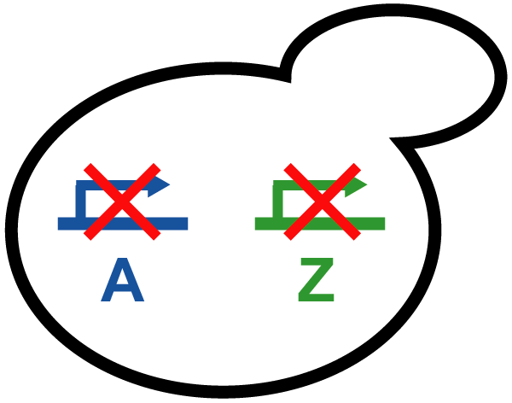
Network Analysis using Cytoscape
Find biological processes
underlying a phenotype
Databases
Literature
Network
Information
Expert knowledge
Network
Analysis
Experimental Data

Slide 38
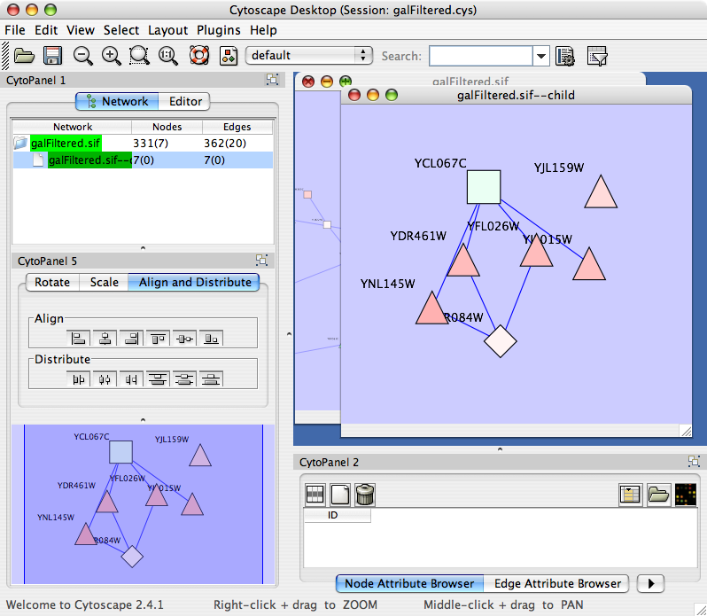
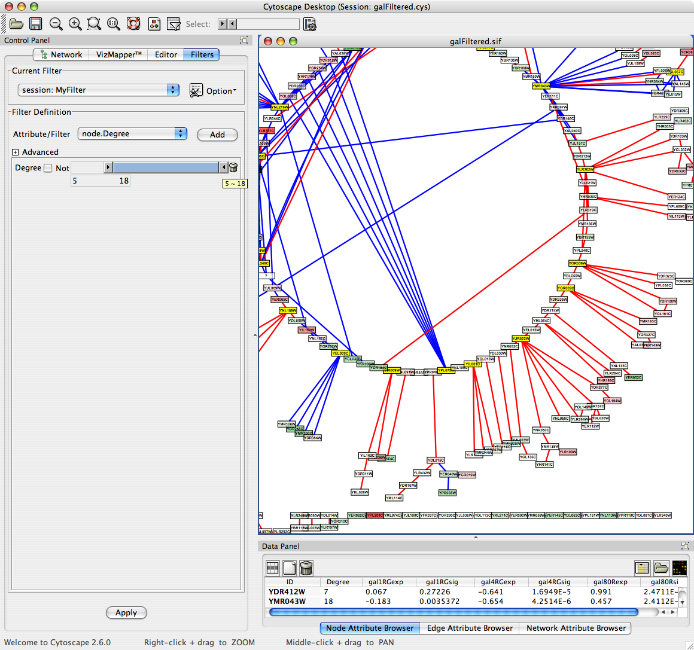
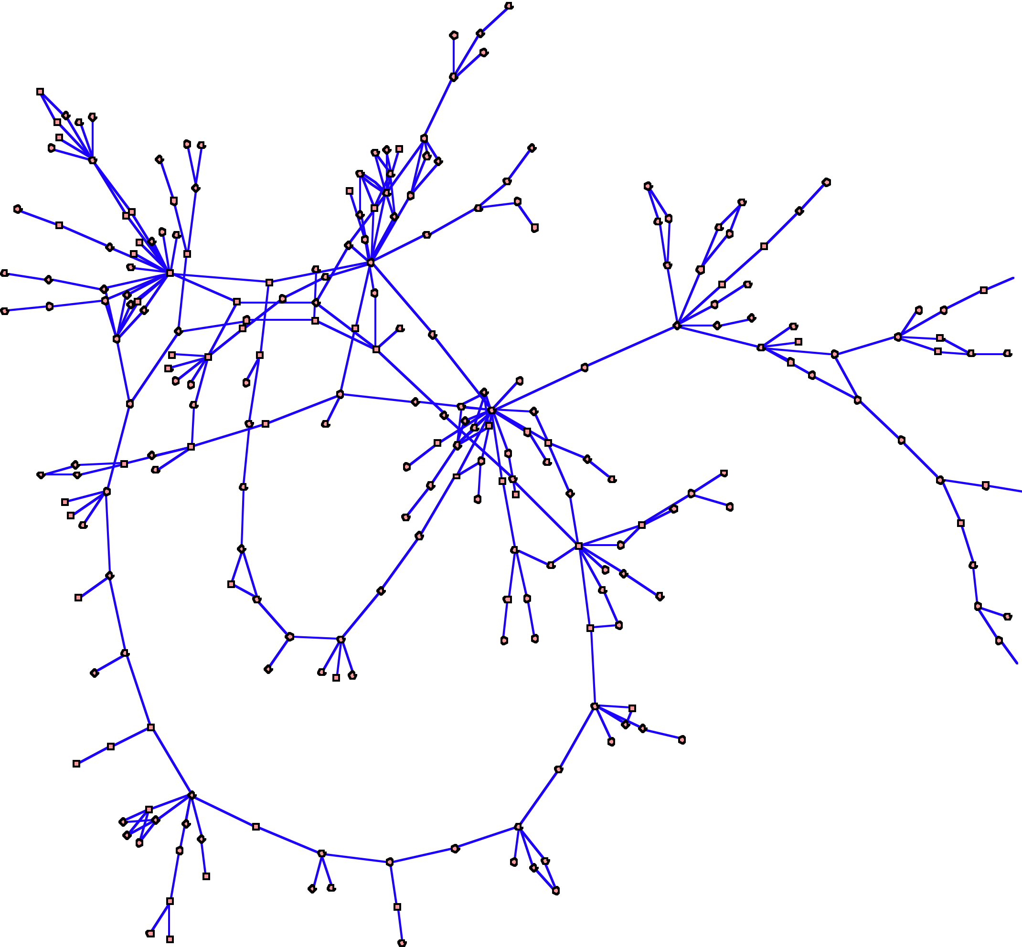

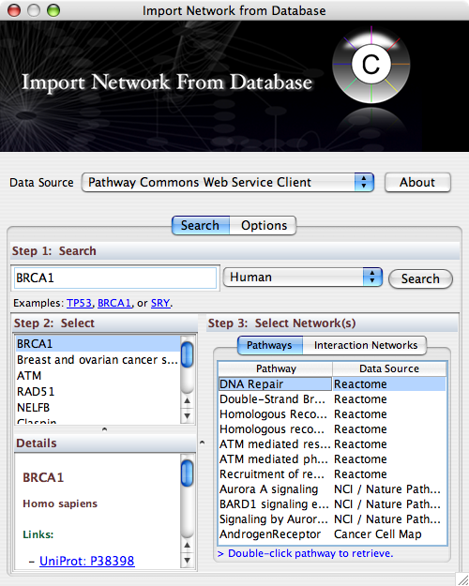
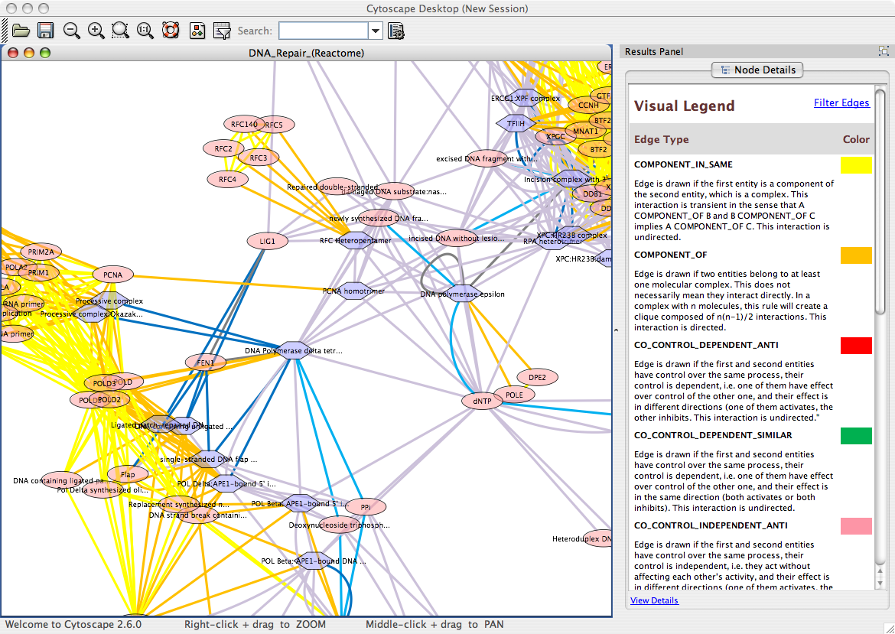
Manipulate Networks
Filter/Query
Interaction Database Search
Automatic Layout

Slide 39
Active Community
http://www.cytoscape.org
Help
  8 tutorials, >10 case studies
  Mailing lists for discussion
  Documentation, data sets
Annual Conferences
10,000s users, 2500 downloads/month
>80 Plugins Extend Functionality
  Build your own, requires programming
Cline MS et al. Integration of biological networks and gene expression data using Cytoscape Nat Protoc. 2007;2(10):2366-82

Slide 40
Cytoscape Demo
Gary Bader
Version 2.7
www.cytoscape.org

Slide 41
Working with Data
Loading Networks
Loading and Manipulating Attributes

Slide 42
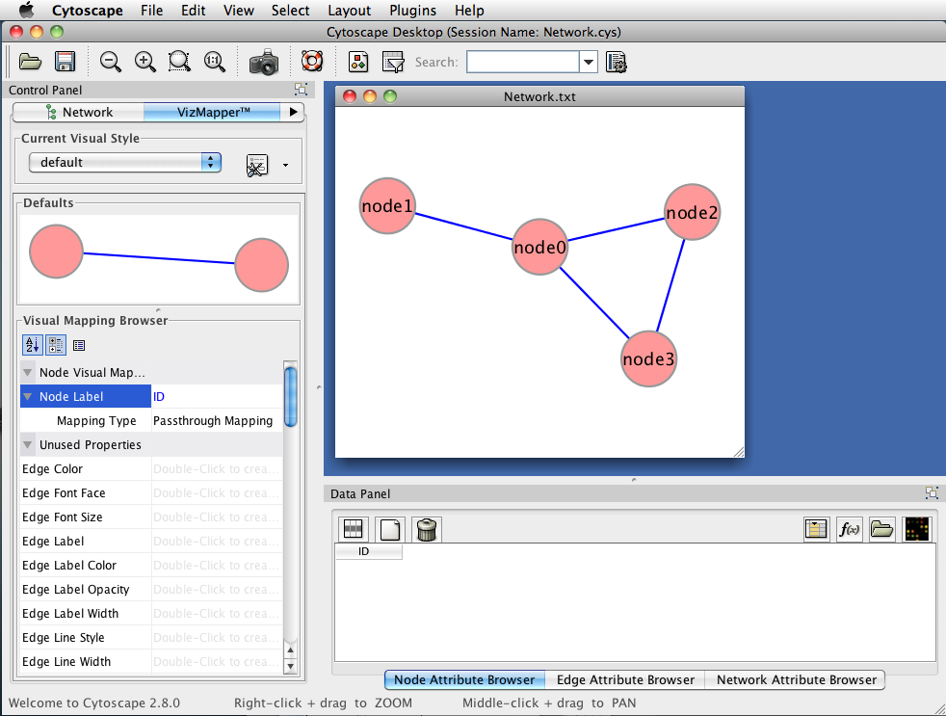
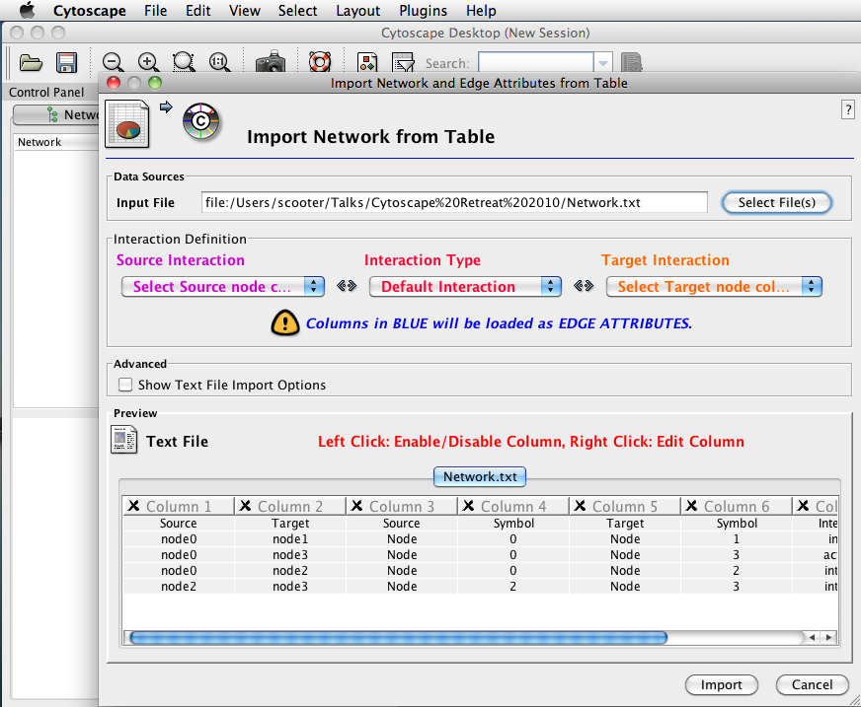
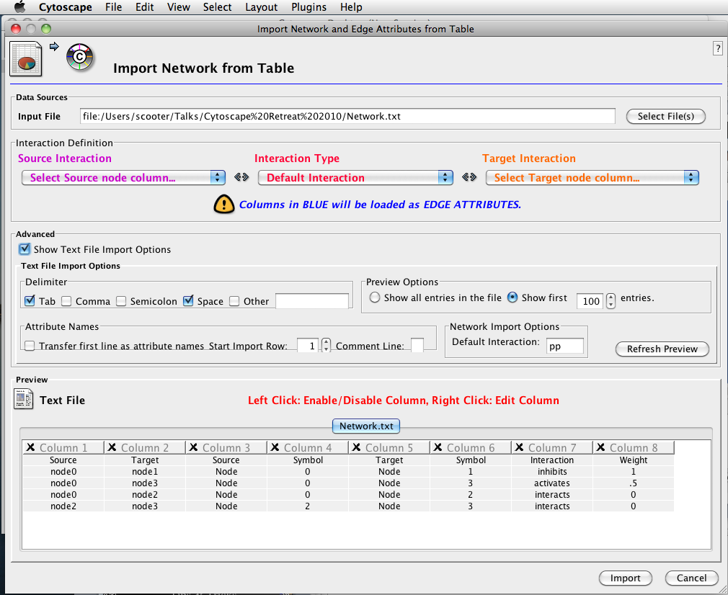
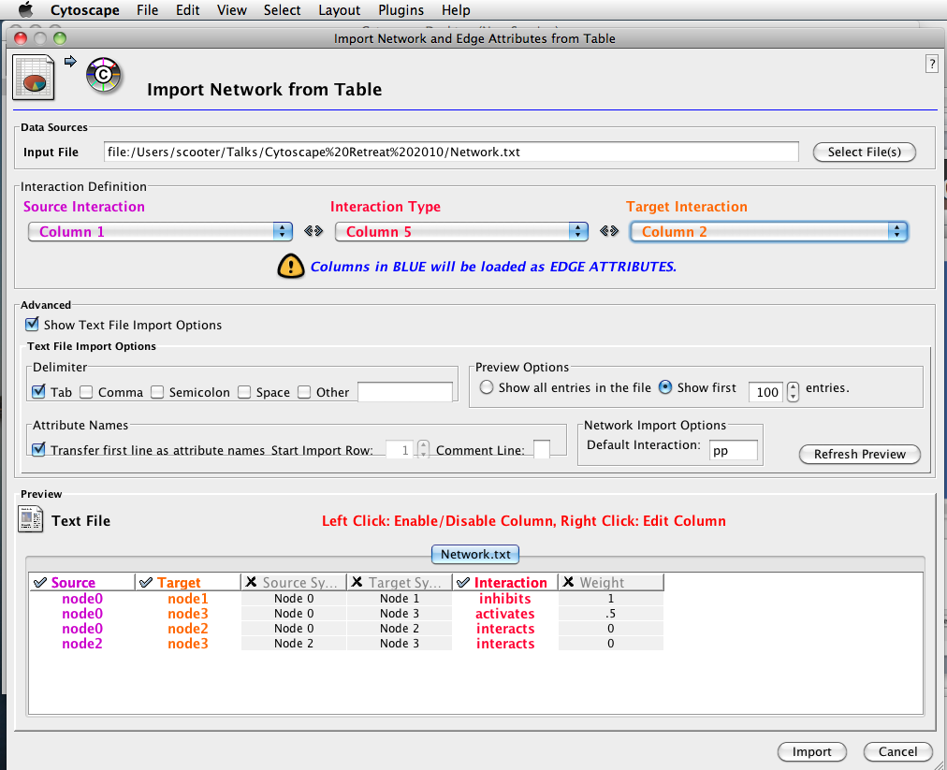
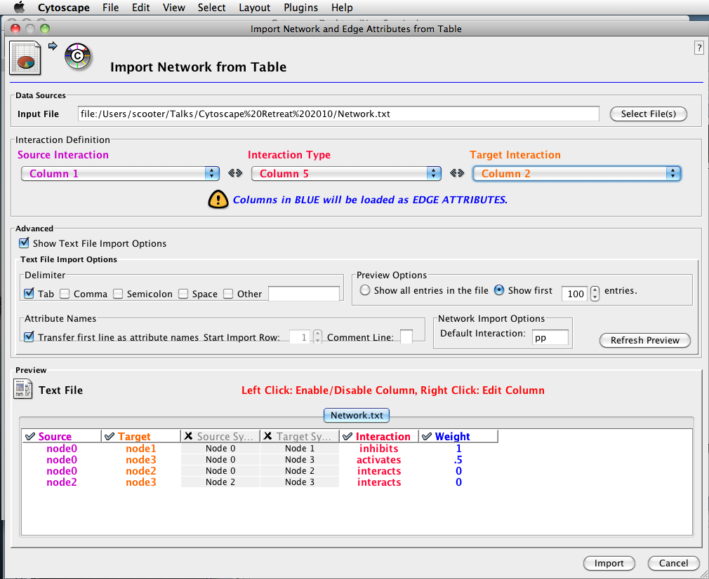
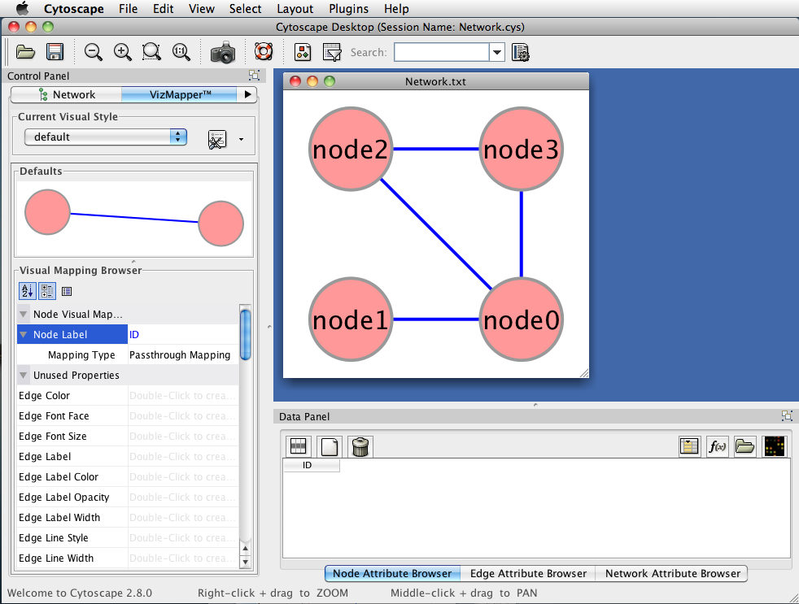
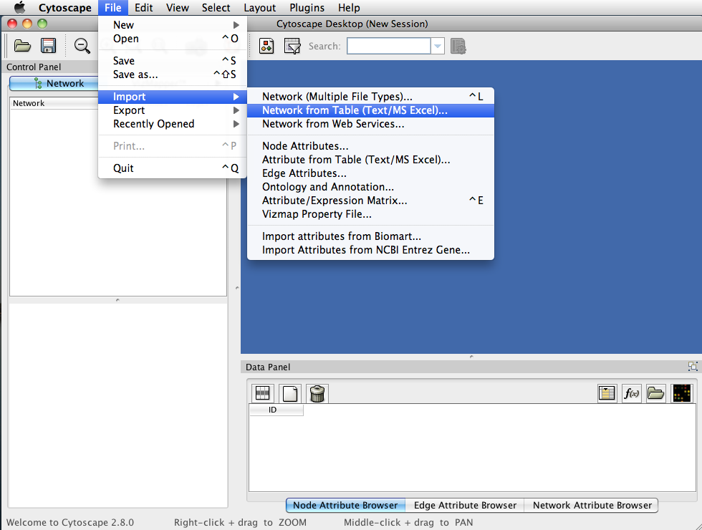
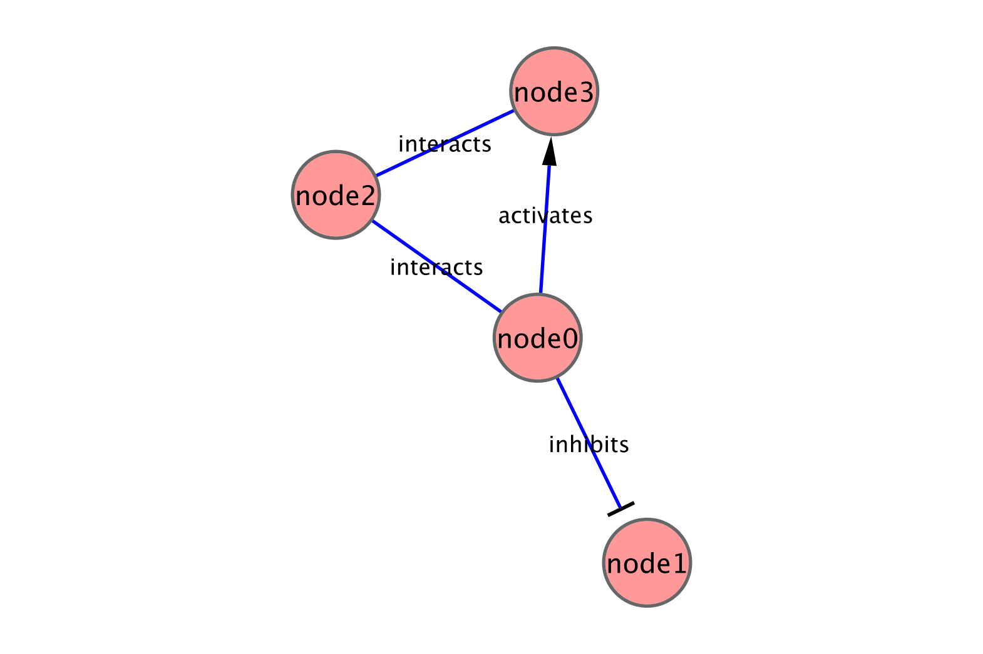
Loading Networks
Use import network from table:
  Excel file
  Comma or tab delimited text

Slide 43
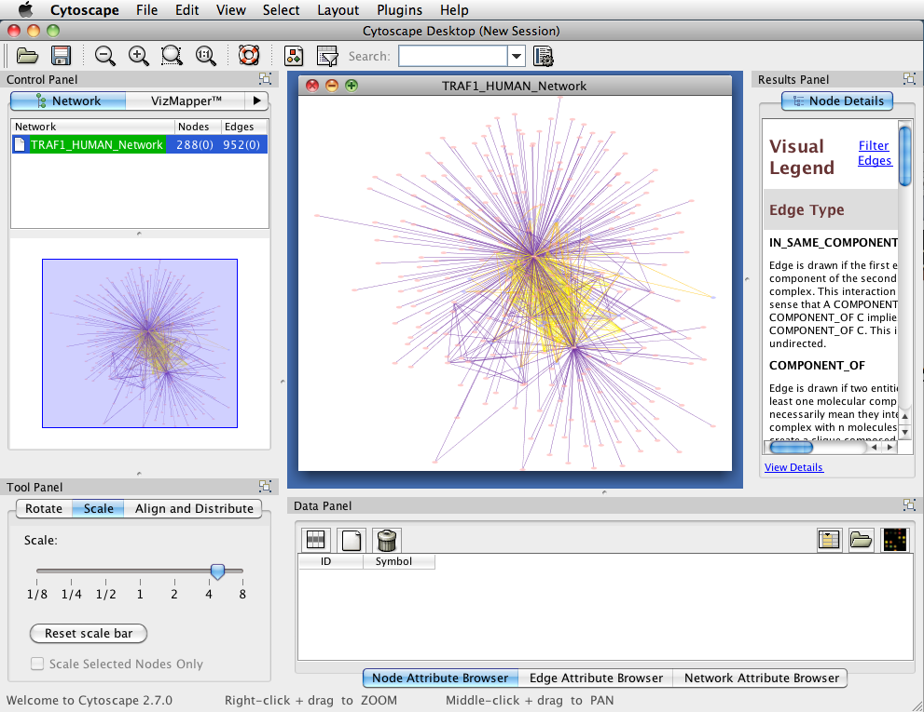
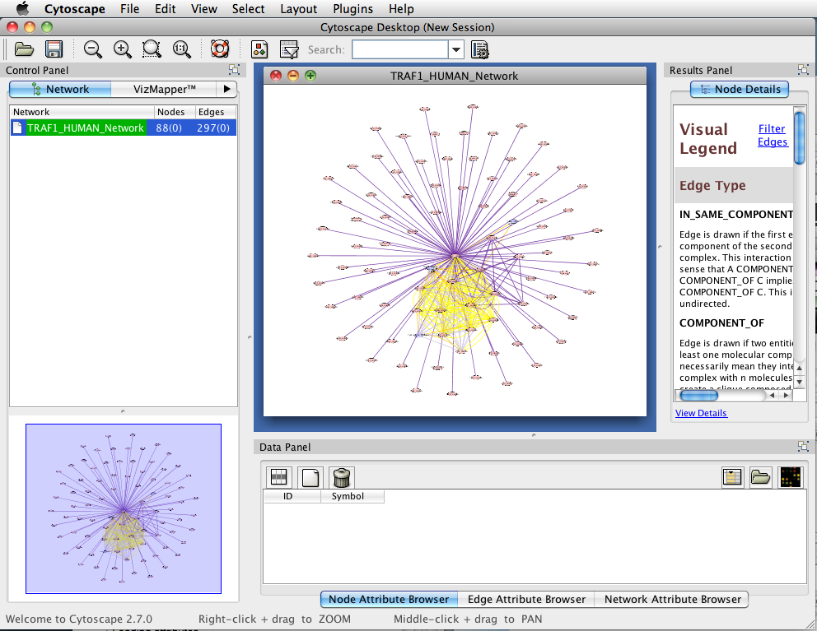
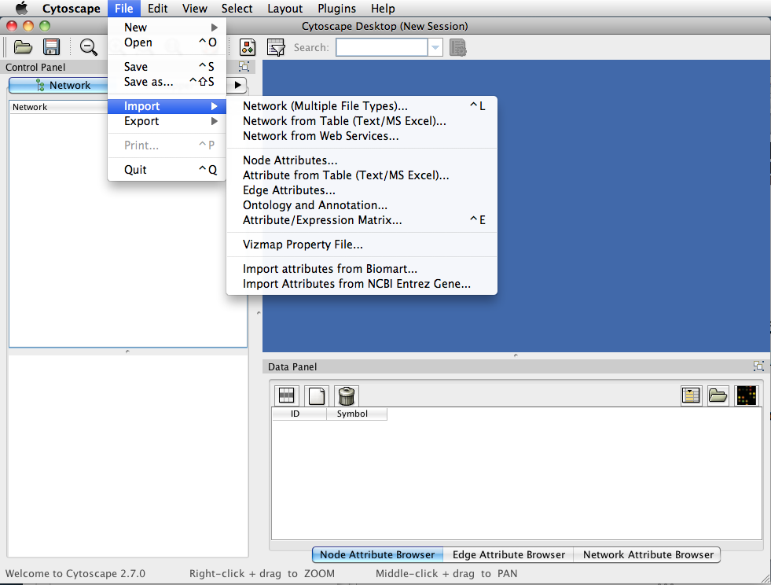
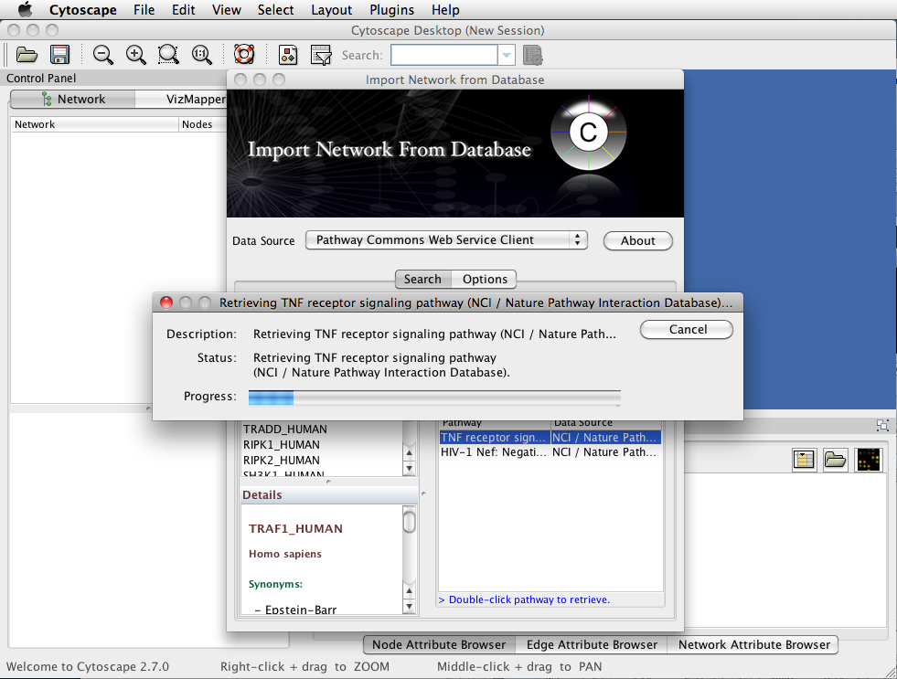
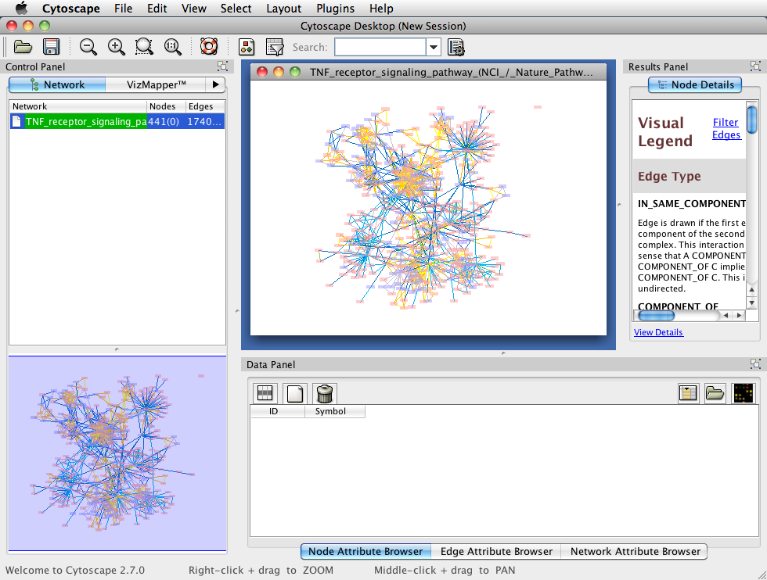




Loading Networks
Use import network from table:
  Excel file
  Comma or tab delimited text
Use import network from web services
  Allows query and load from a variety of services:
    Pathway commons
    WikiPathways (if GPML plugin is loaded)
    NCBI Entrez EUtilities

Slide 44




Loading Attributes
Loading attributes
  Use import attribute from table
The Data Panel

Slide 45



Loading Attributes
Loading attributes
  Use import attribute from table
The Data Panel

Slide 46
Visualizing data
Data mapping
Layouts

Slide 47








Data mapping
Mapping of data values associated with graph elements onto graph visuals
Visual attributes
  Node fill color, border color, border width, size, shape, opacity, label
  Edge type, color, width, ending type, ending size, ending color
Mapping types
  Passthrough (labels)
  Continuous (numeric values)
  Discrete (categories)
Notes:
Add some examples

Slide 48
Data mapping
Avoid cluttering your visualization with too much data
  Map the data you are specifically interested in to call out meaningful differences
  Mapping too much data to visual attributes may just confuse the viewer
  Can always create multiple networks and map different values
Notes:
Add counter examples

Slide 49







Layouts
Layouts determine the location of nodes and (sometimes) the paths of edges
Types:
  Simple
    Grid
    Partitions
  Hierarchical
    layout data as a tree or hierarchy
    Works best when there are no loops
  Circular (Radial)
    arrange nodes around a circle
    could use node attributes to govern position
      e.g. degree sorted
Notes:
Need layout examples

Slide 50



Layouts
Types:
  Force-Directed
    simulate edges as springs
    may be weighted or unweighted
  Combining layouts
    Use a general layout (force directed) for the entire graph, but use hierarchical or radial to focus on a particular portion
  Multi-layer layouts
    Partition graph, layout each partition then layout partitions
  Many, many others

Slide 51
Layouts
Use layouts to convey the relationships between the nodes
Layout algorithms may need to be “tuned” to fit your network
  Layouts→Settings… menu
Lots of parameters to change layout algorithm behavior
Can also consider laying out portions of your network

Slide 52
Lab Time
Try out Cytoscape
http://opentutorials.rbvi.ucsf.edu/index.php/Tutorial:Introduction_to_Cytoscape
Survey – Developers
  Beginner, have already developed plugin?

Slide 53

FYI
Desktop
Network manager
CytoPanels
Canvas
Network overview
Attribute browser

Slide 54

yFiles Organic
FYI

Slide 55

yFiles Circular
FYI

Slide 56


Network Layout
FYI
15 algorithms available through plugins
Demo: Move, zoom/pan, rotate, scale, align

Slide 57

Create Subnetwork
FYI

Slide 58
Create Subnetwork
FYI

Slide 59
Visual Style
FYI
Customized views of experimental data in a network context
Network has node and edge attributes
    E.g. expression data, GO function, interaction type
Mapped to visual attributes
    E.g. node/edge size, shape, colour…
E.g. Visualize gene expression data as node colour gradient on the network

Slide 60
Visual Style
FYI
Load “Your Favorite Network”

Slide 61


Visual Style
FYI
Load “Your Favorite Expression”
Dataset

Slide 62

Visual Style
FYI
Map expression values to node colours using a continuous mapper

Slide 63

Visual Style
FYI
Expression data mapped
to node colours

Slide 64
Network Filtering
FYI

Slide 65
Interaction Database Search
FYI

Slide 66

FYI

Slide 67

FYI

Slide 68
Public Seminar
Break 10:30-11:00
Seminar: 11:00-12:00
Lunch: 12:00-13:00
Lab time: 13:00-13:30

Slide 69
Lab Time
Try out Cytoscape
http://opentutorials.rbvi.ucsf.edu/index.php/Tutorial:Introduction_to_Cytoscape
Timing: until 13:45

Slide 70
Tips and Tricks
Gary Bader

Slide 71
Tips & Tricks
“Root graph”
  “There is one graph to rule them all….”
  The networks in Cytoscape are all “views” on a single graph.
  Changing the attribute for a node in one network will also change that attribute for a node with the same ID in all other loaded networks
  There is no way to “copy” a node and keep the same ID
  Make a copy of the session

Slide 72
Tips & Tricks
Network views
  When you open a large network, you will not get a view by default
  To improve interactive performance, Cytoscape has the concept of “Levels of Detail”
    Some visual attributes will only be apparent when you zoom in
    The level of detail for various attributes can be changed in the preferences
    To see what things will look like at full detail:
      View→Show Graphics Details

Slide 73
Tips & Tricks
Sessions
  Sessions save pretty much everything:
    Networks
    Properties
    Visual styles
    Screen sizes
  Saving a session on a large screen may require some resizing when opened on your laptop

Slide 74
Tips & Tricks
Logging
  By default, Cytoscape writes it’s logs to the Error Dialog: Help→Error Dialog
  Can change a preference to write it to the console
    Edit→Preferences→Properties…
    Set logger.console to true
    Don’t forget to save your preferences
    Restart Cytoscape
  (can also turn on debugging: cytoscape.debug, but I don’t recommend it)

Slide 75
Tips & Tricks
Memory
  Cytoscape uses lots of it
  Doesn’t like to let go of it
  An occasional restart when working with large networks is a good thing
  Destroy views when you don’t need them
  Java doesn’t give us a good way to get the memory right at start time
    Cytoscape 2.7 does a much better job at “guessing” good default memory sizes than previous versions

Slide 76
Tips & Tricks
.cytoscape directory
  Your defaults and any plugins downloaded from the plugin manager will go here
  Sometimes, if things get really messed up, deleting (or renaming) this directory can give you a “clean slate”
Plugin manager
  “Outdated” doesn’t necessarily mean “won’t work”
  Plugin authors don’t always update their plugins immediately after new releases
  Click on “Show outdated plugins” to see the entire list of plugins.

Slide 77
Cytoscape Workflow
Piet Molenaar

Slide 78
Cytoscape Workflow
Load Networks (Import network data into Cytoscape)‏
Load Attributes (Get data about networks into Cytoscape)‏
Analyze and Visualize Networks
Prepare for Publication
A specific example of this workflow:
  Cline, et al. “Integration of biological networks and gene expression data using Cytoscape”, Nature Protocols, 2, 2366-2382 (2007).
Notes:
TODO:
What: Schedules first part of talk
How
Bridge: So this is all about networks....

Slide 79
All kinds of network data…
Physical interactions
  Protein – Protein interactions
  Protein – DNA interactions
  Metabolic interactions
Functional interactions
  Co-expression relations
  Genetic interactions
  Knockout/siRNA – targets
Notes:
What: All kinds of data; combine them
Bridge:Combining: standards…

Slide 80
Pre-formatted Network Files
Cytoscape supports many popular file formats:
  SIF (Simple Interaction Format)‏
  GML (Graph Markup Language)‏
  XGMML (eXtensible Graph Markup and Modeling Language)‏
  BioPAX (Biological Pathway Data)‏
  PSI-MI 1 & 2.5 (Protein Standards Initiative)‏
  SBML Level 2 (Systems Biology Markup Language)‏
  KGML (KEGG Markup Language)‏
Available for download from data sources (URLs, web-services, formatted table files)
Notes:
What: Standards: combinations, comparing and quantification
Bridge:Web based dbs

Slide 81

Internet Databases
Cytoscape version 2.6
  web service clients: import networks directly from several trusted internet resources
  IntAct (EMBL-EBI)
  PathwayCommons (collection of data resources)
  NCBI Entrez Gene
  Many more will be included...
Notes:
What: loads available
Bridge; Demo this using our favorite gene….

Slide 82
Text Mining
Computationally extract gene relationships from text, usually PubMed abstracts
Literature search tool, lots of network data
BUT not perfect
  Problems recognizing gene names
  Natural language processing not perfect
Agilent Literature Search Cytoscape plugin
Others: E.g. iHOP
  www.ihop-net.org/UniPub/iHOP/

Slide 83




Slide 84



Cytoscape Network produced by Literature Search.
Abstract from the scientific literature
Sentences for an edge

Slide 85
Demo Creating Network
From Internet Database
Notes:
What: lots of possibilities
How:
Ask gene of interest
Choose myc; select wnt from ncbi
Show possibilities, simple / complex
Note the datafield
Bridge: As a plugin developer…

Slide 86
Cytoscape Workflow
Load Networks (Get network data into Cytoscape)‏
Load Attributes (Get data about networks into Cytoscape)‏
Analyze and Visualize Networks
Prepare for Publication
Notes:
What: Dressing the network with attributes; this is where it gets interesting
Bridge: So attributes…

Slide 87
What are Attributes?
Any data that describes or provides details about the nodes and edges in the network
  Gene Expression Data
  Mass Spectrometry Data
  Protein Structure Information
  Gene Ontology (GO) terms
  Interaction Confidence Values, etc
Cytoscape support multiple data types
  Numbers (integer, float)
  Text (string)
  Logical (Boolean)
  Lists…
Notes:
What; Anything can be attributed
Bridge: How does this work in cytoscape

Slide 88

Attribute Management
Select Attributes for Display
Node or Edge ID
Strings and
floating type of attributes
Specific Attribute Tabs
Notes:
What: the attribute panel; attributes are mapped through ids
How: go through pointers
Bridge: How do we enter atts

Slide 89
Load Attributes:
Import Attribute Files
Map data about Networks onto Networks.
Attributes can be loaded in many of the same ways as networks.
  Import pre-formatted attribute files
  Import formatted text or Excel files
  Create attributes manually in attribute editor
  Load attributes from web services
  ID mapping though node attributes
Notes:
Bridge: Ids are of utmost importance

Slide 90
Public Sources of Gene Attributes
Ensembl BioMart (eukaryotes)
  http://www.ensembl.org
Entrez Gene (general)
  http://www.ncbi.nlm.nih.gov/sites/entrez?db=gene
Model organism databases
  E.g. SGD: http://www.yeastgenome.org/
Many others: discuss during lab

Slide 91



Ensembl BioMart
Convenient access to gene list annotation
Select genome
Select filters
Select attributes
to download

Slide 92


Slide 93
Gene and Protein Identifiers
Identifiers (IDs) are ideally unique, stable names or numbers that help track database records
  E.g. Social Insurance Number, Entrez Gene ID 41232
Gene and protein information stored in many databases
  → Genes have many IDs
Records for: Gene, DNA, RNA, Protein
  Important to recognize the correct record type
  E.g. Entrez Gene records don’t store sequence. They link to DNA regions, RNA transcripts and proteins e.g. in RefSeq, which stores sequence.

Slide 94

NCBI Database Links
For your information
NCBI:
U.S. National Center for Biotechnology Information
Part of National Library of Medicine (NLM)
http://www.ncbi.nlm.nih.gov/Database/datamodel/data_nodes.swf

Slide 95
Common Identifiers
For your information
Gene
Ensembl ENSG00000139618
Entrez Gene 675
Unigene Hs.34012
RNA transcript
GenBank BC026160.1
RefSeq NM_000059
Ensembl ENST00000380152
Protein
Ensembl ENSP00000369497
RefSeq NP_000050.2
UniProt BRCA2_HUMAN or A1YBP1_HUMAN
IPI IPI00412408.1
EMBL AF309413
PDB 1MIU
Species-specific
HUGO HGNC BRCA2
MGI MGI:109337
RGD 2219
ZFIN ZDB-GENE-060510-3
FlyBase CG9097
WormBase WBGene00002299 or ZK1067.1
SGD S000002187 or YDL029W
Annotations
InterPro IPR015252
OMIM 600185
Pfam PF09104
Gene Ontology GO:0000724
SNPs rs28897757
Experimental Platform
Affymetrix 208368_3p_s_at
Agilent A_23_P99452
CodeLink GE60169
Illumina GI_4502450-S
Red = Recommended

Slide 96
Identifier Mapping
So many IDs!
  Mapping (conversion) is a headache
Four main uses
  Searching for a favorite gene name
  Link to related resources
  Identifier translation
    E.g. Genes to proteins, Entrez Gene to Affy
  Unification during dataset merging
    Equivalent records

Slide 97


ID Mapping Services
Synergizer
  http://llama.med.harvard.edu/synergizer/translate/
Ensembl BioMart
  http://www.ensembl.org
PICR (proteins only)
  http://www.ebi.ac.uk/Tools/picr/

Slide 98
ID Mapping Challenges
Avoid errors: map IDs correctly
Gene name ambiguity – not a good ID
  e.g. FLJ92943, LFS1, TRP53, p53
  Better to use the standard gene symbol: TP53
Excel error-introduction
  OCT4 is changed to October-4
Problems reaching 100% coverage
  E.g. due to version issues
  Use multiple sources to increase coverage
Zeeberg BR et al. Mistaken identifiers: gene name errors can be introduced inadvertently when using Excel in bioinformatics BMC Bioinformatics. 2004 Jun 23;5:80

Slide 99
Recommendations
For proteins and genes
  (doesn’t consider splice forms)
Map everything to Entrez Gene IDs using a spreadsheet
If 100% coverage desired, manually curate missing mappings
Be careful of Excel auto conversions – especially when pasting large gene lists!

Slide 100
Demo:
(1) Mapping ids
(2) Annotating Network with Array Data
Notes:
What: array data -> probesets
How: Use the entrez geneids to map on top array probes
Use hg133 array
Show array data; analyzed Mas5 gcos
Myc knock out experiment
Emphasize real data!
Show that myc data is present
Show how to make visible in attbrowser
Show possibility of batch annotation
Show addition of other datatypes
Bridge: But this is not visualized yet!!!

Slide 101
Cytoscape Workflow
Load Networks (Get network data into Cytoscape)‏
Load Attributes (Get data about networks into Cytoscape)‏
Analyze and Visualize Networks
Prepare for Publication
Notes:
Bridge: Vizmapper

Slide 102


Visual Data Integration
1. Network Data
YDR382W pp YDL130W
YDR382W pp YFL039C
YFL039C pp YCL040W
YFL039C pp YHR179W
VizMapper
2. Attribute Data
ExpressionValue
YCL040W = 0.542
YDL130W = -0.123
YDR382W = -0.058
YFL039C = 0.192
YHR179W = 0.078
Notes:
Bridge: the vizmapper, what can it do

Slide 103

VizMapper
List of Visual Styles
Default Visual Style Editor
List of Visual Attributes
List of Data Attributes
Mapping definition
Notes:
Bridge: what about those mappings

Slide 104
Types of mappings
  Continuous Data mapped to Continuous Visual Attributes (e.g. gene expression levels mapped to node color)
  Continuous Data mapped to Discrete Visual Attributes (e.g. p-value categories mapped to node shape)
  Discrete (categorical) Data to Discrete Visual Attributes (e.g. GO annotation mapped to node shape)
  Discrete Data mapped to Continuous Visual Attributes (e.g. multiple GO terms mapped to pie coloring)
Notes:
Bridge: now we know all about vizmapper; lets use it
TODO ;Plaatjes erbij

Slide 105
Demo Applying Vizmapping
Notes:
TODO: check this demo
Apply vizmapping to the wnt network
Show that cytoscape can import specific array data
Bridge: of course also api

Slide 106





VistaClara
Visualization for gene expression data
Heat maps, sorting, animation

Slide 107
Demo network filtering and layout
Notes:
What: Play around!
Show linkout
Show search
Show topological filter
Show combined filter
Show layouts
Bridge: and now in api

Slide 108

Linkout
Nodes and Edges act as hyperlinks to external databases.
User-configurable URLs
Collection of the biological results for the publication
Notes:
Todo: update

Slide 109
Cytoscape Workflow
Load Networks (Get network data into Cytoscape)‏
Load Attributes (Get data about networks into Cytoscape)‏
Analyze and Visualize Networks
Prepare for Publication

Slide 110


Publication quality figures
Publication Quality Graphics in several formats
  PDF, EPS, SVG, PNG, JPEG, and BMP
Export Session to HTML for Web

Slide 111
Break
14:45-15:15

Slide 112
Lab Time
Try out workflow
  Agilent Literature Search, VistaClara
  ID mapping services
  Use your own data or sample data that comes with Cytoscape
Resource:
  http://opentutorials.rbvi.ucsf.edu/index.php/Tutorial:Introduction_to_Cytoscape
Timing: 15:15-16:15

Slide 114
Gene List to Network Lab
Start with a gene list and find a network
  MIMI – Protein-protein interactions (PPI)
  STRING, GeneMANIA – Functional interactions
  AgilentLitSearch – text mined interactions
  BisoGeNet – another PPI source
Gene function prediction with STRING and GeneMANIA

Slide 115

MiMI: Protein interactions

Slide 116

http://string.embl.de

Slide 117

http://string.embl.de

Slide 118

http://www.genemania.org/plugin/

Slide 119


Slide 120


Slide 121

http://www.genemania.org

Slide 122
Gene List to Network Lab
Enter gene list into STRING and GeneMANIA websites
Save results as text and load into Cytoscape
Try MIMI plugin
Gene function prediction: input a list of genes known to be in a given function. Ask STRING or GeneMANIA to find more genes like those (guilt by association)

Slide 123

PPI network analysis Lab
Load protein-protein interaction network (e.g. YeastHighQuality: 7000 Yeast interactions among 3000 proteins)
Visualize

Slide 124
PPI network analysis
Load protein-protein interaction network (eg YeastHighQuality)
Visualize
  Large dataset; hairball
  Layouts don’t help
Cluster - MCODE, ClusterMaker, ActiveModules

Slide 125
Analysis
Find Network Clusters - MCODE Plugin
Network clusters are highly interconnected sub-networks that may be also partly overlapping
Clusters in a protein-protein interaction network have been shown to represent protein complexes and parts of biological pathways
Clusters in a protein similarity network represent protein families
Network clustering is available through the MCODE Cytoscape plugin
Notes:
125

Slide 126
MCODE plug-in demo
Notes:
126
TODO add button

Slide 127

Bader & Hogue, BMC Bioinformatics 2003 4(1):2
Notes:
127

Slide 128
Proteasome 26S
Ribosome
Proteasome 20S
RNA Splicing
RNA Pol core
Notes:
128

Slide 129
Lab Time
Try out MCODE with your dataset of choice
Or use one of the other sets available
If you find something interesting please share! ☺

Slide 130

Gene Ontology analysis Lab
Describes gene function
1. Agreed upon terms (controlled vocabulary)
  Biological process
  Cellular component
  Molecular function
2. Genome annotation
www.geneontology.org
Notes:
130

Slide 131
BinGO plugin
Calculates over-representation of a subset of genes with respect to a background set in a specific GO category
Input: subnetwork, or list
  Background set by user
Output: tree with nodes color reflecting overrepresentation; also as lists
Caveats: Gene identifiers must match; low GO term coverage, GO bias, Background determining

Slide 132

BiNGO
Hypergeometric p-value
Multiple testing correction
(Benjamini-Hochberg FDR)
Maere, S., Heymans, K. and Kuiper, M
Bioinformatics 21, 3448-3449, 2005
Notes:
132

Slide 133
Lab time
Try BINGO with subsets from e.g. MCODE

Slide 134
Analysis Lab
Find Active Subnetworks Lab
Active modules are sub-networks that show differential expression over user-specified conditions or time-points
  Microarray gene-expression attributes
  Mass-spectrometry protein abundance
Method
  Calculate z-score/node, ZA score/subgraph, correct for random expression data sampling
  Score over multiple experimental conditions
  Simulated annealing-based search method is used to find the high scoring networks
Notes:
134

Slide 135


Analysis Lab
Find Active Subnetworks Lab
jActiveModules plug-in
  Input: interaction network and p-values for gene expression values over several conditions
  Output: significant sub-networks that show differential expression over one or several conditions
Ideker T et al. Science 2001; Bioinformatics 2002

Slide 136
Lab Time
Try out jActiveModules
Use the gal expression dataset

Slide 137
Analysis Lab
Find Network Motifs - Netmatch plugin
Network motif is a sub-network that occurs significantly more often than by chance alone
Input: query and target networks, optional node/edge labels
Output: topological query matches as subgraphs of target network
Supports: subgraph matching, node/edge labels, label wildcards, approximate paths
http://alpha.dmi.unict.it/~ctnyu/netmatch.html
Notes:
137
TODO: add screenshots!!

Slide 138


Finding specific biological relevant TF-PPI sub-networks
Query
Results
Ferro et al. Bioinformatics 2007
Notes:
138

Slide 139




Find Signaling Pathways
Potential signaling pathways from plasma membrane to nucleus via cytoplasm
NetMatch Results
Signaling pathway example
NetMatch query
Ras
MAP Kinase Cascade
Raf-1
Mek
MAPK
Shortest path between
subgraph matches
TFs
Nucleus - Growth Control
Mitogenesis

Slide 140


Find Expressed Motifs
NetMatch Results
NetMatch query
Find specific
subgraphs where
certain nodes are
significantly differentially
expressed
Protein Differential Expression Significance
YLR075W 1.7255E-4
YGR085C 2.639E-4
YPR102C 3.7183E-4

Slide 141
Lab Time
Find motifs with Netmatch
Use the provided dataset (not yet in sampleData)

Slide 142
Cytoscape 2.8
Cytoscape 2.8 beta out now
  http://chianti.ucsd.edu/Cyto-2_8-beta/
  Equations in attributes
  Custom graphics
Demo of new features

Slide 143

http://cytoscapeweb.cytoscape.org/

Slide 144
Day 2

Slide 145


Visualizing gene set enrichment analysis results
Gary Bader

Slide 146
Enrichment Test: General Framework
Experimental
Data
Enrichment Table
Spindle 0.00001
Apoptosis 0.00025
ENRICHMENT
TEST
Gene-set
Databases

Slide 147
Excellent idea used to interpret data in hundreds of papers
GO.id GO.name p.value covercover.rat Deg.mdn Deg.iqr
GO:0042330 taxis 2.18E-06 23 0.056930693 54.94499375 9.139238998
GO:0006935 chemotaxis 2.18E-06 23 0.060209424 54.94499375 9.139238998
GO:0002460 adaptive immune response based on somatic recombination 7.10E-05 25 0.111111111 57.32306955 16.97054864
GO:0002250 adaptive immune response 7.10E-05 25 0.111111111 57.32306955 16.97054864
GO:0002443 leukocyte mediated immunity 0.000419328 23 0.097046414 58.27890582 15.58333739
GO:0019724 B cell mediated immunity 0.000683758 20 0.114285714 57.84161096 15.03496347
GO:0030099 myeloid cell differentiation 0.000691589 24 0.089219331 62.22171598 10.35284833
GO:0002252 immune effector process 0.000775626 31 0.090116279 58.27890582 23.86214773
GO:0050764 regulation of phagocytosis 0.000792138 8 0.2 53.54786293 5.742849971
GO:0050766 positive regulation of phagocytosis 0.000792138 8 0.216216216 53.54786293 5.742849971
GO:0002449 lymphocyte mediated immunity 0.00087216 22 0.101851852 57.84161096 16.13171132
GO:0019838 growth factor binding 0.000913285 15 0.068181818 83.0405088 10.58734852
GO:0051258 protein polymerization 0.00108876 17 0.080952381 57.97543252 17.31639968
GO:0005789 endoplasmic reticulum membrane 0.001178198 18 0.036072144 64.02284752 12.05209158
GO:0016064 immunoglobulin mediated immune response 0.001444464 19 0.113095238 58.27890582 15.58333739
GO:0007507 heart development 0.001991562 26 0.052313883 84.02538284 18.60761304
GO:0009617 response to bacterium 0.002552999 10 0.027173913 52.75249873 23.23104637
GO:0030100 regulation of endocytosis 0.002658555 11 0.099099099 56.38041132 16.02486889
GO:0002526 acute inflammatory response 0.002660742 24 0.103004292 57.80098769 24.94311116
GO:0045807 positive regulation of endocytosis 0.002903401 9 0.147540984 54.94499375 6.769909171
GO:0002274 myeloid leukocyte activation 0.002969661 7 0.077777778 54.94499375 16.07042339
GO:0008652 amino acid biosynthetic process 0.003502921 7 0.017241379 45.19797271 31.18248579
GO:0050727 regulation of inflammatory response 0.004999055 7 0.084337349 54.94499375 7.737346076
GO:0002253 activation of immune response 0.00500146 23 0.116161616 60.29679989 18.41103376
GO:0002684 positive regulation of immune system process 0.006581245 27 0.111570248 60.29679989 22.05051447
GO:0050778 positive regulation of immune response 0.006581245 27 0.113924051 60.29679989 22.05051447
GO:0019882 antigen processing and presentation 0.007244488 7 0.029661017 54.94499375 16.58797889
GO:0002682 regulation of immune system process 0.007252134 29 0.099656357 61.05645008 22.65935206
GO:0050776 regulation of immune response 0.007252134 29 0.102112676 61.05645008 22.65935206
GO:0043086 negative regulation of enzyme activity 0.008017022 9 0.040723982 53.28031076 17.48904224
GO:0006909 phagocytosis 0.008106069 10 0.080645161 55.66270253 12.47536747
GO:0002573 myeloid leukocyte differentiation 0.008174948 10 0.092592593 62.86577216 9.401887596
GO:0006959 humoral immune response 0.008396095 16 0.044568245 55.05654091 18.94209565
GO:0046649 lymphocyte activation 0.009044401 29 0.059917355 61.92213317 21.03553355
GO:0030595 leukocyte chemotaxis 0.009707319 7 0.101449275 56.33116709 6.945510559
GO:0006469 negative regulation of protein kinase activity 0.010782155 7 0.046357616 52.22863516 12.58524145
GO:0051348 negative regulation of transferase activity 0.010782155 7 0.04516129 52.22863516 12.58524145
GO:0007179 transforming growth factor beta receptor signaling pathw 0.012630825 13 0.071038251 83.49440788 12.63256309
GO:0005520 insulin-like growth factor binding 0.012950071 9 0.097826087 81.41963394 7.528247832
GO:0042110 T cell activation 0.013410548 20 0.064516129 59.77891783 26.06174863
GO:0002455 humoral immune response mediated by circulating immunogl 0.016780163 10 0.125 54.70766244 14.2572143
GO:0005830 cytosolic ribosome (sensu Eukaryota) 0.016907351 8 0.01843318 61.68933284 7.814673781

Slide 148
Excellent idea used to interpret data in hundreds of papers
  But! Major cognitive burden relating overlapping gene sets
GO.id GO.name p.value covercover.rat Deg.mdn Deg.iqr
GO:0042330 taxis 2.18E-06 23 0.056930693 54.94499375 9.139238998
GO:0006935 chemotaxis 2.18E-06 23 0.060209424 54.94499375 9.139238998
GO:0002460 adaptive immune response based on somatic recombination 7.10E-05 25 0.111111111 57.32306955 16.97054864
GO:0002250 adaptive immune response 7.10E-05 25 0.111111111 57.32306955 16.97054864
GO:0002443 leukocyte mediated immunity 0.000419328 23 0.097046414 58.27890582 15.58333739
GO:0019724 B cell mediated immunity 0.000683758 20 0.114285714 57.84161096 15.03496347
GO:0030099 myeloid cell differentiation 0.000691589 24 0.089219331 62.22171598 10.35284833
GO:0002252 immune effector process 0.000775626 31 0.090116279 58.27890582 23.86214773
GO:0050764 regulation of phagocytosis 0.000792138 8 0.2 53.54786293 5.742849971
GO:0050766 positive regulation of phagocytosis 0.000792138 8 0.216216216 53.54786293 5.742849971
GO:0002449 lymphocyte mediated immunity 0.00087216 22 0.101851852 57.84161096 16.13171132
GO:0019838 growth factor binding 0.000913285 15 0.068181818 83.0405088 10.58734852
GO:0051258 protein polymerization 0.00108876 17 0.080952381 57.97543252 17.31639968
GO:0005789 endoplasmic reticulum membrane 0.001178198 18 0.036072144 64.02284752 12.05209158
GO:0016064 immunoglobulin mediated immune response 0.001444464 19 0.113095238 58.27890582 15.58333739
GO:0007507 heart development 0.001991562 26 0.052313883 84.02538284 18.60761304
GO:0009617 response to bacterium 0.002552999 10 0.027173913 52.75249873 23.23104637
GO:0030100 regulation of endocytosis 0.002658555 11 0.099099099 56.38041132 16.02486889
GO:0002526 acute inflammatory response 0.002660742 24 0.103004292 57.80098769 24.94311116
GO:0045807 positive regulation of endocytosis 0.002903401 9 0.147540984 54.94499375 6.769909171
GO:0002274 myeloid leukocyte activation 0.002969661 7 0.077777778 54.94499375 16.07042339
GO:0008652 amino acid biosynthetic process 0.003502921 7 0.017241379 45.19797271 31.18248579
GO:0050727 regulation of inflammatory response 0.004999055 7 0.084337349 54.94499375 7.737346076
GO:0002253 activation of immune response 0.00500146 23 0.116161616 60.29679989 18.41103376
GO:0002684 positive regulation of immune system process 0.006581245 27 0.111570248 60.29679989 22.05051447
GO:0050778 positive regulation of immune response 0.006581245 27 0.113924051 60.29679989 22.05051447
GO:0019882 antigen processing and presentation 0.007244488 7 0.029661017 54.94499375 16.58797889
GO:0002682 regulation of immune system process 0.007252134 29 0.099656357 61.05645008 22.65935206
GO:0050776 regulation of immune response 0.007252134 29 0.102112676 61.05645008 22.65935206
GO:0043086 negative regulation of enzyme activity 0.008017022 9 0.040723982 53.28031076 17.48904224
GO:0006909 phagocytosis 0.008106069 10 0.080645161 55.66270253 12.47536747
GO:0002573 myeloid leukocyte differentiation 0.008174948 10 0.092592593 62.86577216 9.401887596
GO:0006959 humoral immune response 0.008396095 16 0.044568245 55.05654091 18.94209565
GO:0046649 lymphocyte activation 0.009044401 29 0.059917355 61.92213317 21.03553355
GO:0030595 leukocyte chemotaxis 0.009707319 7 0.101449275 56.33116709 6.945510559
GO:0006469 negative regulation of protein kinase activity 0.010782155 7 0.046357616 52.22863516 12.58524145
GO:0051348 negative regulation of transferase activity 0.010782155 7 0.04516129 52.22863516 12.58524145
GO:0007179 transforming growth factor beta receptor signaling pathw 0.012630825 13 0.071038251 83.49440788 12.63256309
GO:0005520 insulin-like growth factor binding 0.012950071 9 0.097826087 81.41963394 7.528247832
GO:0042110 T cell activation 0.013410548 20 0.064516129 59.77891783 26.06174863
GO:0002455 humoral immune response mediated by circulating immunogl 0.016780163 10 0.125 54.70766244 14.2572143
GO:0005830 cytosolic ribosome (sensu Eukaryota) 0.016907351 8 0.01843318 61.68933284 7.814673781

Slide 149

Enrichment Map
http://baderlab.org/Software/EnrichmentMap/
GENE SETS
ENRICHMENT MAP
Spindle
Ca⁺⁺ Channels
Gene.A
Gene.B
Gene.C
Gene.G
Gene.H
Gene.I
Apoptosis
MAPK
Gene.D
Gene.E
Gene.F
Gene.L
Gene.M
Gene.N
Use available gene-set scoring models
  threshold dependent (e.g. Fisher’s) or threshold free (e.g. GSEA, GOrilla)
Use the network framework to organize gene-sets exploiting their inter-dependencies

Slide 150

Gene Set Enrichment Analysis (GSEA)
Ranked Gene List
UP
(A > B)
GSEA
DOWN
(B > A)
Gene-sets

Slide 151
Enrichment Map
Overlap

Slide 152
Enrichment Map: use case I
Single enrichment
Estrogen treatment of breast cancer cells
Design:
2-time points, two-class
Gene set Database:
Gene Ontology
 | 12 hrs | 24 hrs
Estrogen-treated | 3 | 3
Untreated | 3 | 3

Slide 153


Slide 154


Slide 155


Slide 156
Enrichment Map: use case II
Comparison of two enrichments
Estrogen treatment of breast cancer cells
Design:
2-time points, two-class
Gene set Database:
Gene Ontology
 | 12 hrs | 24 hrs
Estrogen-treated | 3 | 3
Untreated | 3 | 3

Slide 158


Slide 159

Enrichment Map: use case III
Query Set Analysis

Slide 160

Enrichment Map: use case III
Query Set Analysis
Query Set
(e.g. miRNA Targets)
Overlap significance
(Fisher’s Exact Test)
Overlap coefficient
Gene-sets enriched in gene expression
(e.g. miRNA-1-2 KO )

Slide 161
Autism
Autism Spectrum Disorder (ASD) definition:
Genetics
  highly heritable
    monozygotic twin concordance 90-60%
    (depending on the stringency of diagnosis)
  known genetics:
    5-15% rare single-gene disorders and chromosomal re-arrangements
    de-novo CNV previously reported in 5-10% of ASD cases
    GWA (Genome-wide Association Studies) have been able to explain only a small amount of heritability
Pinto et al. Functional impact of global rare copy number variation in autism spectrum disorders. Nature. 2010 Jun 9.

Slide 162
CNV screening of Autism
Rare Copy Number Variation screening (DEL, DUP)
  889 Case and 1146 Ctrl (European Ancestry)
  Illumina Infinium 1M-single SNP
  high quality rare CNV (90% PCR validation)
    identification by the three main algorithms required for detection (QuantiSNP, iPattern, PennCNV)
    frequency < 1%
    length > 30 kb
Statistics
  average CNV size: 182.7 kb
  median CNV number per individual: 2
  difference in CNV distribution: only genic DEL higher
  > 5.7% ASD individuals carry at least one de-novo CNV
Pinto et al. Functional impact of global rare copy number variation in autism spectrum disorders. Nature. 2010 Jun 9.

Slide 163
Gene-set sources
Gene Ontology
  Biological Process
  Cellular Component
  Molecular Function
Pathways
  KEGG
  NCI
  Reactome
PFAM domains
Number of gene-sets:
  Unfiltered (all): 14,433
  Filtered (5 << 700 genes): 6,129
  Tested (counts > 0): 3,493
Pinto et al. Functional impact of global rare copy number variation in autism spectrum disorders. Nature. 2010 Jun 9.

Slide 164

Pinto et al. Functional impact of global rare copy number variation in autism spectrum disorders. Nature. 2010 Jun 9.

Slide 165

http://baderlab.org/Software/EnrichmentMap/

Slide 166

Future Work
Add Network visualization support
Pathway visualization and analysis tools

Slide 167


Cluster words according to their co-occurrence in labels to preserve semantic meaning.
Layla Oesper
Google Summer of Code

Slide 168

Thanks for your attention!

Slide 169





Enrichment Map
Acknowledgments
Bader Lab
Andrew Emili
Ruth Isserlin
Daniele Merico
Gary Bader
Emili Lab
Oliver Stueker
Terrence Donnelly CCBR
(University of Toronto)

Slide 170
Lab Time
Try out Cytoscape
http://opentutorials.rbvi.ucsf.edu/index.php/Tutorial:Introduction_to_Cytoscape

